Slide 1
Digital portfolio
STUDENT NAME: Yashvanth Kumar V
REGISTER NO AND NMID: 32324U09088/4CCDF3FDFFA7E8EB64448201E28CE128
DEPARTMENT: BCA
COLLEGE: Voorhees College ,Thiruvalluvar University

Slide 2
ENTREPRENUR PORTFOLIO
Navigating the future

Slide 3
Agenda
Problem Statement
Project Overview
End Users
Tools and Technologies
Portfolio design and Layout
Features and Functionality
Results and Screenshots
Conclusion
GitHub

Slide 4
Problem Statement
Entrepreneurs often lack a professional digital presence to showcase their ideas, achievements, and projects. This reduces visibility and networking opportunities.

Slide 5
Project Overview
The project is a personal portfolio website designed with HTML, CSS, and JavaScript. It highlights the entrepreneur’s skills, start-up ventures, and provides easy contact options.
5

Slide 6
Who are the end uses?
Entrepreneurs
Investors
Recruiters
Collaborators

Slide 7
Tools and Techniques
HTML5
CSS3 (Flexbox, Grid, Animations)
JavaScript (ES6)
Visual Studio Code
GitHub for version control

Slide 8
Portfolio design and layout
The portfolio is designed with a modern color palette, responsive layout, smooth scrolling, and mobile-friendly navigation. Sections include Home, About, Skills, Start-up, and Contact.

Slide 9
Portfolio design and layout
Sections include:
Home: Welcoming introduction with name and tagline
About Me: Entrepreneur’s journey, passion, and values
Skills: Grid layout showcasing key entrepreneurial skills
Start-up: Details about the business venture and mission
Contact Us: Contact information and interactive form with success message

Slide 10
Features and functionality
Responsive navigation bar
Smooth scroll
Animated sections
Skills grid
Start-up description
Contact form with success message
Footer with credits
Used root in this website to access color palate effeciently in website

Slide 11
Result and Screenshots
The portfolio is fully functional and visually appealing.

Slide 12
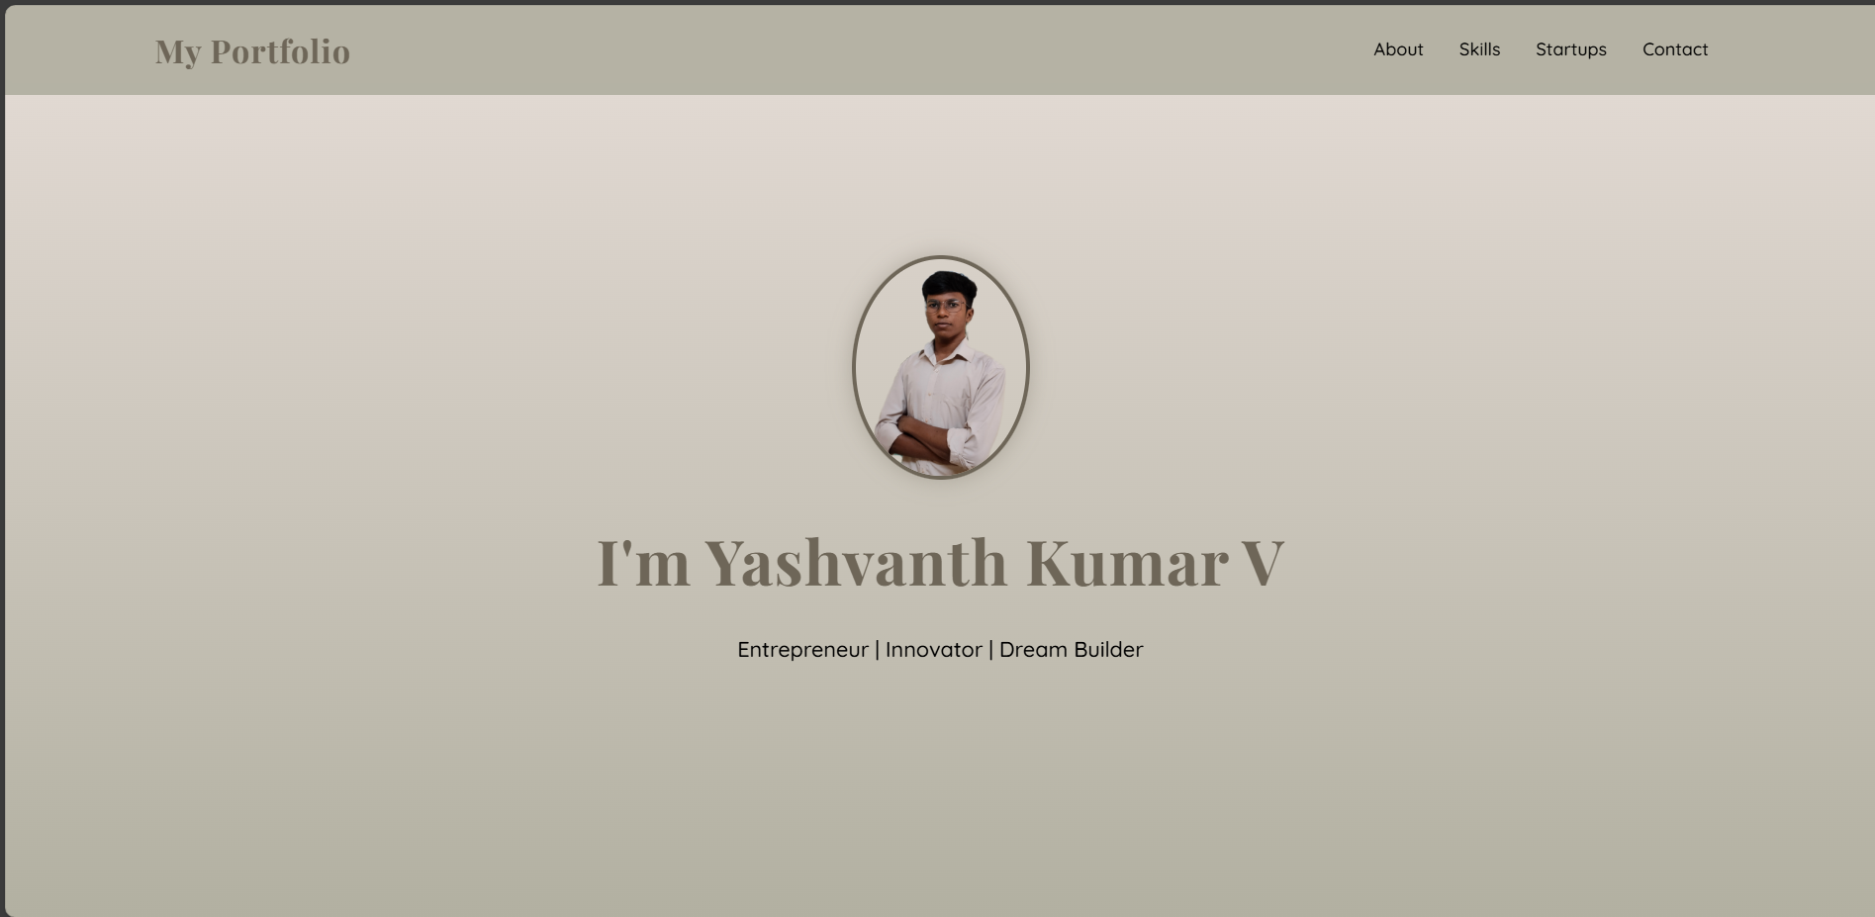
Home page

Slide 13
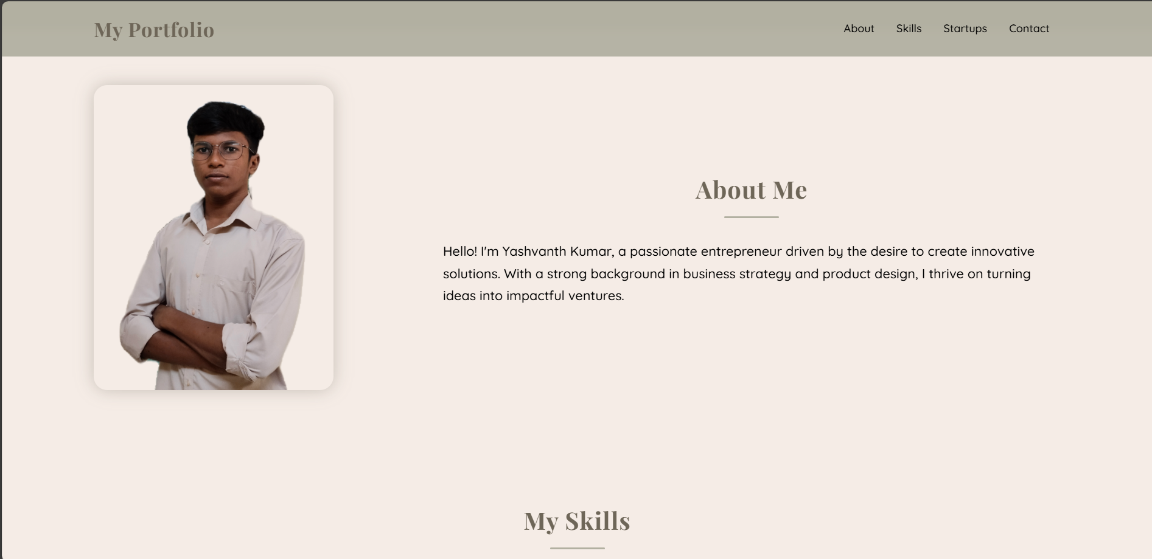
About Me

Slide 14
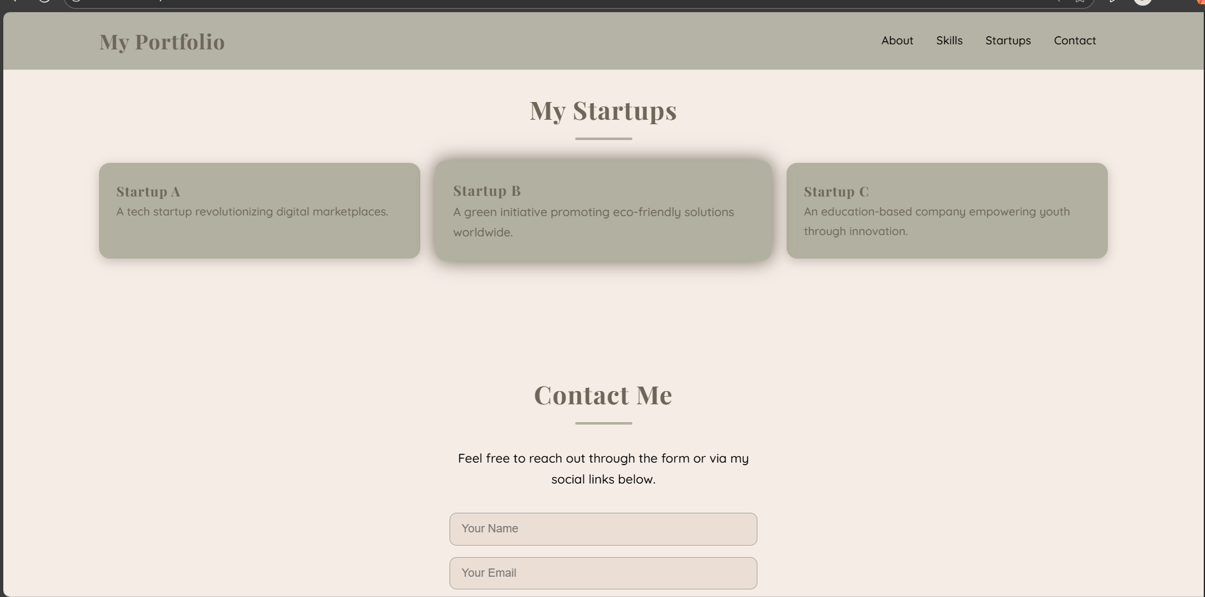
Startups

Slide 15
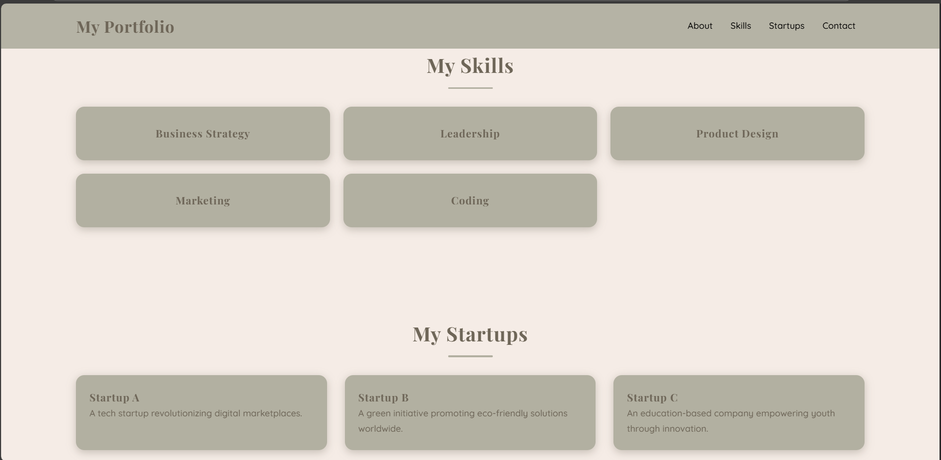
My skills

Slide 16
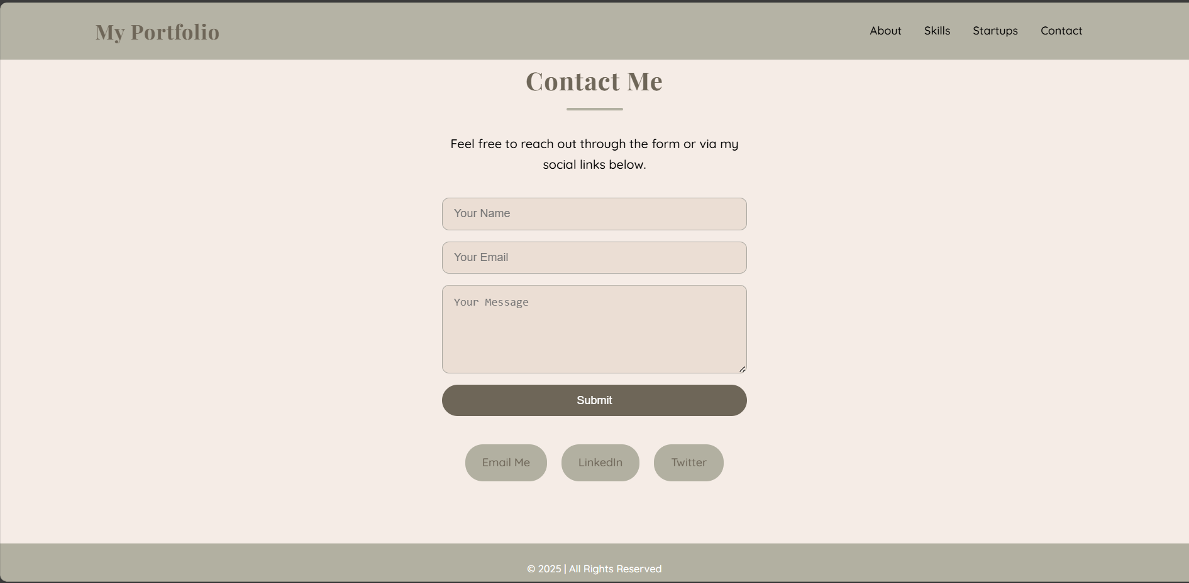
Contant Me

Slide 17
CONCLUTION
This portfolio helps build a strong digital identity, improve professional networking, and create opportunities for collaboration and growth.
17

Slide 18
Thank you

